Slide 1
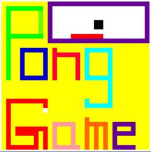
THE PONG GAME
Group Members
W.K.M. Indunil ASP/16/17/030
K.N. Kaluarachchi ASP/16/17/036
M.G.N. Malshani ASP/16/17/119
T.M.C.R. Tennakoon ASP/16/17/132
P.S.V. Perera ASB/16/17/102

Slide 2
INTRODUCTION
Nowadays people either older or youth generation use to play the games in their daily life.
There are a lot of types of games in our routine or even in gadget especially the usage of smartphones toward people.
For example of games, ‘The Pong Game’.
This game actually can build our interest to play in reality toward this game by playing this game in computer.
This game also can fill our time by playing this game from doing nothings.
For our project, we use LabVIEW, which is Pong Game that can choose the auto play mode and display the score board on the game interface.

Slide 3
OBJECTIVE
To study the working principle of computer game in people routine day life.
To avoid the people bored that doing nothing in theirs life that can be fill activity by playing the games.
To apply the LabVIEW project in people life.
To build with any efficiency and skill in thinking while playing the game.

Slide 4
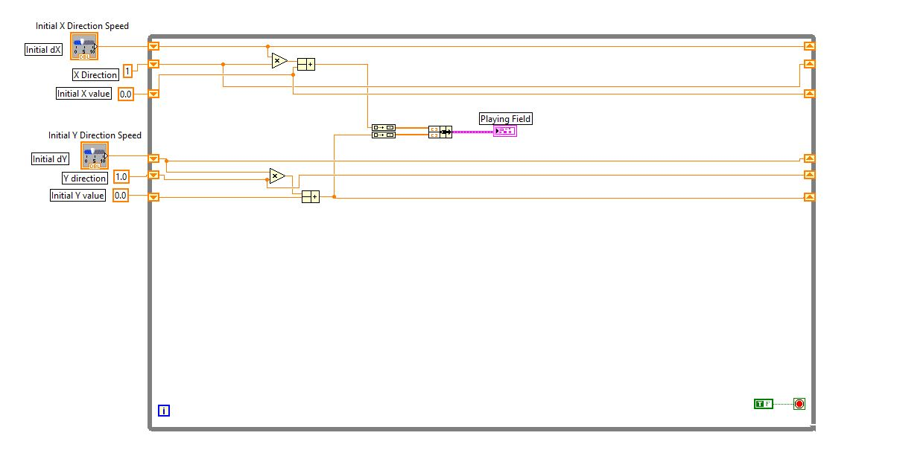
1. Creating the graph of the game

Slide 5
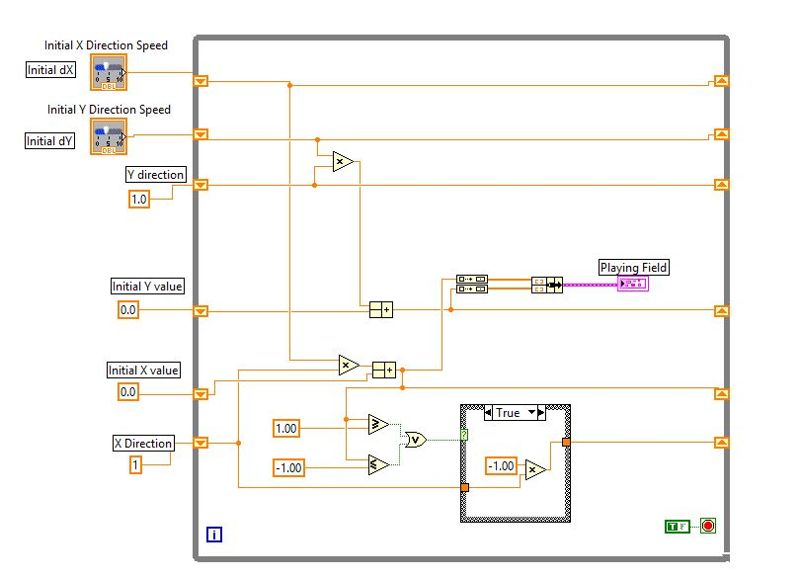
2.Limiting the direction of the ball in x axis.

Slide 6
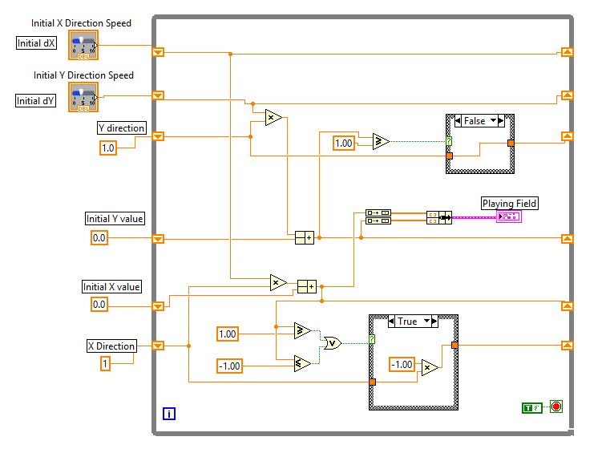
3. Limiting the direction of the ball in the positive side of the Y axis.

Slide 7
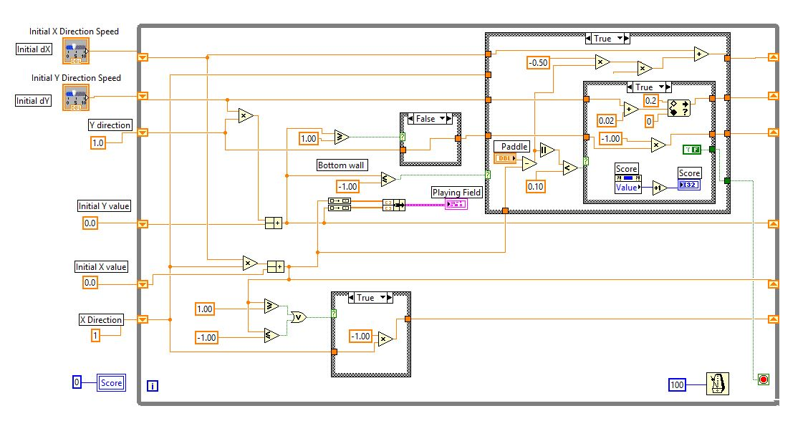
4. Constructing the structure of counting points.

Slide 8
5.Adding the auto play option and the final design.

Slide 9
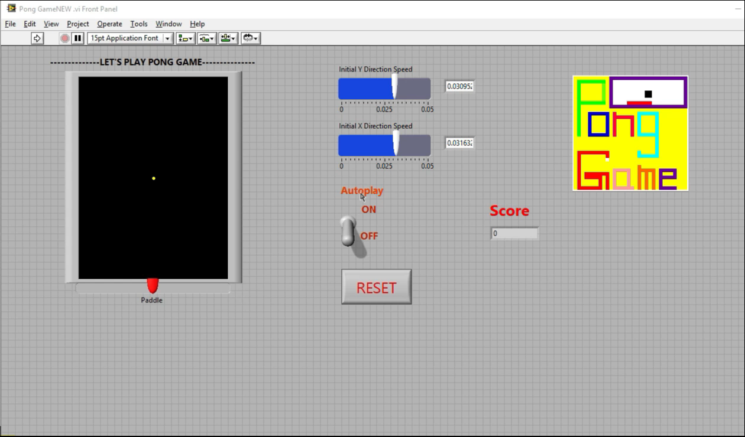
FRONT PANEL

Slide 10
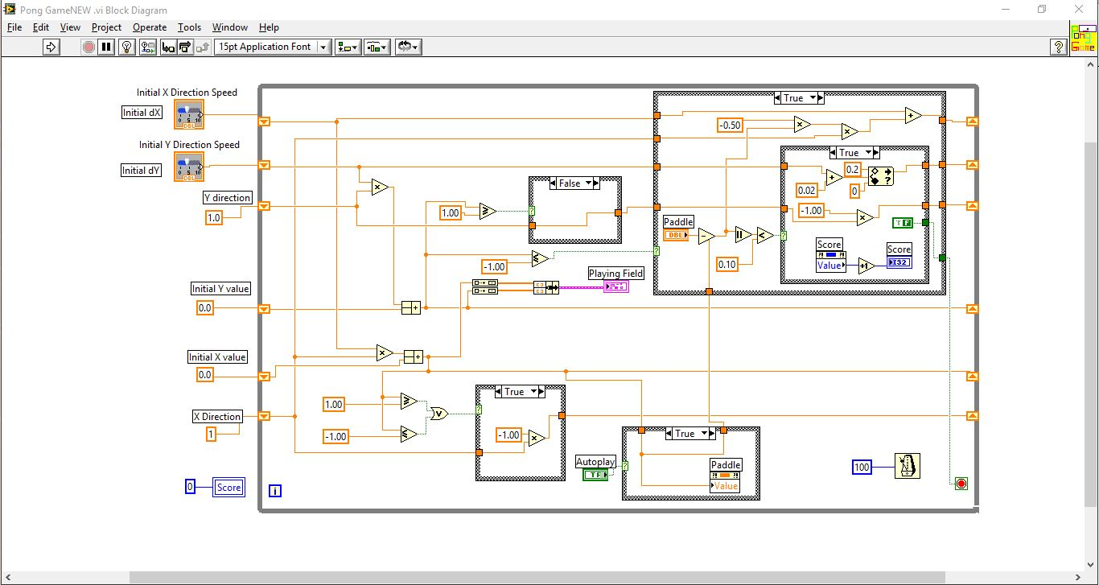
BLOCK DIAGRAM

Slide 11
CONCLUSION
To fill people leisure time by playing this game.
Because it is entertainment and fun.
Emotional satisfaction.
Alternative negative behaviors and keep people occupied and out of trouble.
Practice or learn life skills.
Stress relief.

Slide 12
THANK YOU.

